Slide 1
Programming Multiprocessors with Explicitly Managed Memory Hierarchies
ELEC 6200
Xin Jin
4/30/2010

Slide 2
Outline
Introduction
- Hardware-managed caches
- Software-managed caches, explicitly managed memory (EMM)
- Cell Processor
Programming models developed for the Cell Processor
Performance comparison
Conclusion

Slide 3
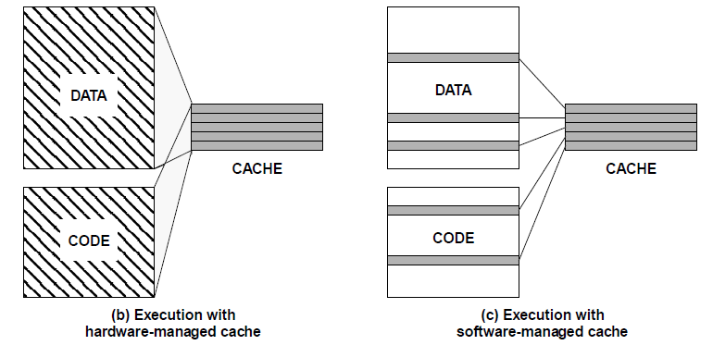
Hardware and Software managed caches
Ref: Software-Managed Caches. Bruce Jacob, Electrical Engineering Department, University of Maryland

Slide 4
Managing the memory hierarchy in multicore processors
Introduces trade-offs in terms of performance, code complexity and optimization effort.
Based on hardware-managed caches
- Single shared address space
- Consistent view of shared memory
Based on software-managed local memories
- Disjoint address spaces
- Need to keep them consistent

Slide 5
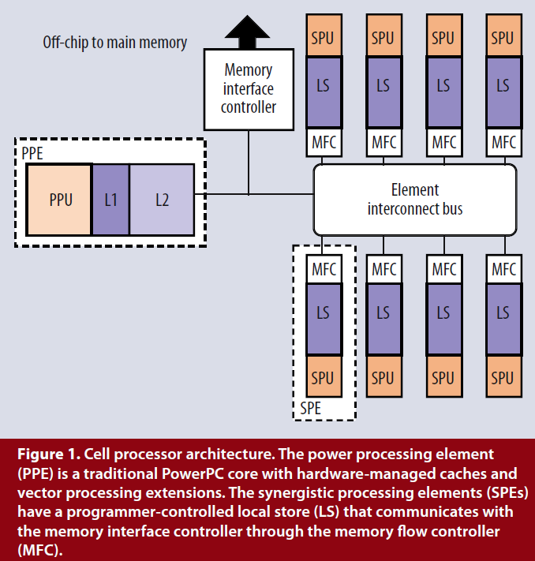
Architecture of Cell Processor
Challenges:
Local memory spaces
Small local storage
Data alignment

Slide 6
Application: Fixedgrid
Fixedgrid is an atmospheric modeling application.
It has two types of computational kernels
1. row discretization
2. column discretization

Slide 7
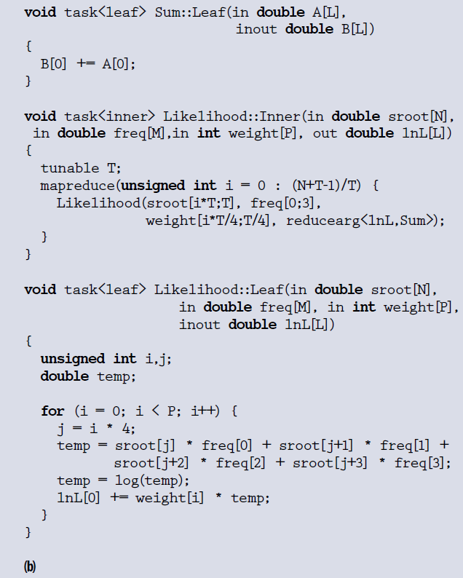
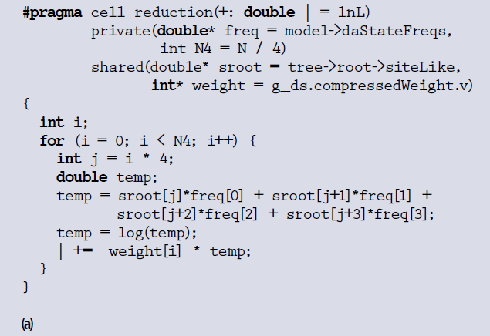
Programming Models
(a) Cellgen Code example
(b) Sequoia Code example

Slide 8
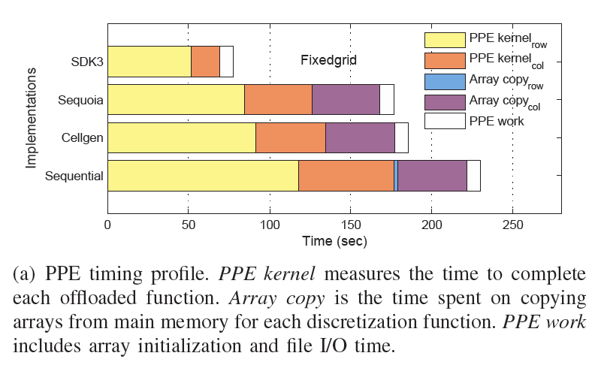
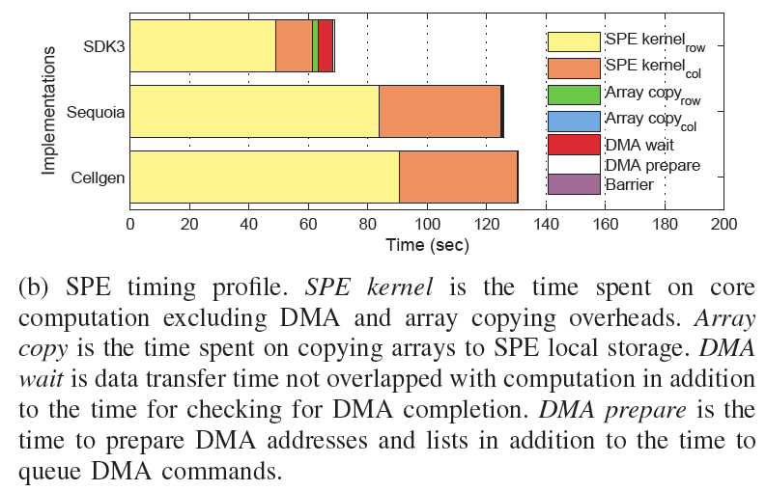
Performance
SDK3 version does not require column data to be reordered on the PPE or SPE
Unlike SDK3, the Cellgen and Sequoia versions do not support this kind of access, and instead the non-contiguous data is rearranged on the PPE

Slide 9
Conclusion
The implicit management of parallelism and locality can produce code with performance comparable to that of code generated from explicit management of locality.
Hand-tuning of data transfers is still necessary for optimization.

Slide 10
Reference
"Programming Multiprocessors with Explicitly Managed Memory Hierarchies," S. Schneider, et al., Computer, vol. 42, no. 12, pp. 28-34, Dec 2009.

